Slide 1
Group 1
Chapter Two (The Honeymoon)
Daniel Rodriguez - Writer
Jorge Cortez - Researcher
Juan Lopez - Graphic Designer

Slide 2
Multimedia clip

Slide 3
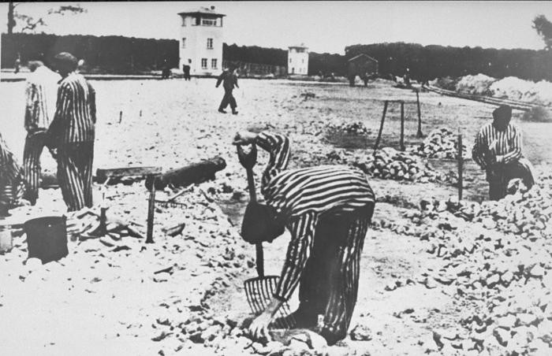
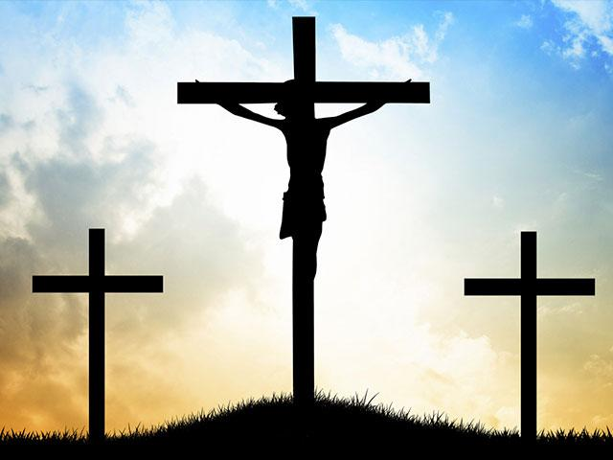
Research
Antisemitism has existed for hundreds of years now and most people believed that it started when they killed Jesus. A pogrom is the organized massacre of a certain people. In Nazis Germany's case it was not only Jews gypsies, and homosexuals.

Slide 4
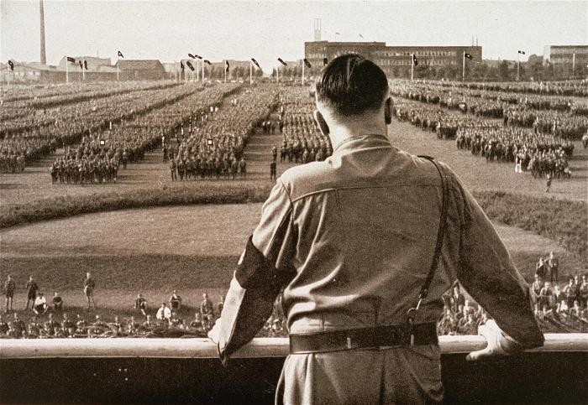
Research (Continued)
The original meaning of the word Holocaust is an animal sacrifice that is consumed by fire.
Hitler’s Holocaust was the mass extermination of people he did not think could be part of an aryan race

Slide 5
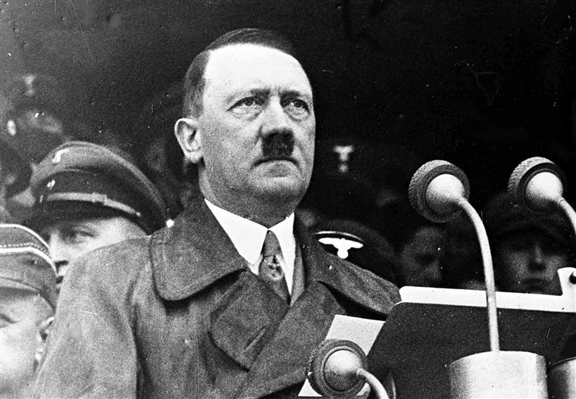
Research (Continued)
In my opinion Hitler saw himself as the chosen one to bring up the perfect nation of people and everyone else was in his way. He joined the party because it showed many similarities to his beliefs. After he joined he became their voice and leader.

Slide 6
Maus Book 1 Chapter 2 Plotline

Slide 7
The Plot
The story opens with Vladek counting his medications and vitamins before Artie asks his father if Anja had any previous boyfriends before she meet him. Vladek replies that yes, Anja did have a boyfriend before he came along and that he was a communist. That detail was soon expanded as Vladek told the story about how Anja and Stefanska, a local seamstress that's friends with Anja, were arrested on the account of translating and spreading communist propaganda. They were eventually released on the account that the police not having enough evidence. At the same time, Anja’s father helped Vladek open up a textile factory in Bielsko. Later, Vladek and Anja had a son who eventually died in the war. Anja had also developed depression and was rehabilitated at a sanitorium in Czechoslovakia. Along the way, they get a first glimpse towards the worsening relationship between jews and germans because a town said they were ‘Jew-Free.’ A riot breaks out in Bielsko so the family moves away to Sosnowiec. Artie then receives a draft notice for the Polish military. Vladek stops his story because he has accidentally dropped his pills and blames it on his eyes. His left eye had to be removed and replaced with a glass because of hemorrhaging and glaucoma. Meanwhile, his right has been developing cataracts. The two soon call it a day.

Slide 8
Maus Book 1 Chapter 2 Introduction and Analysis

Slide 9
Introduction and Analysis
Chapter 2, ‘Honeymoon,’ is about how Vladek and Anja found out about the anti-semitic sentiment beginning to grow, Vladek being drafted and some backstory for Anja.
In this chapter, we also find out that Artie had an older brother, who eventually died in the war.

Slide 10
Closing Statement
Thank you for your time

Slide 11
Works Cited
https://en.m.wikipedia.org/wiki/The_Holocaust
https://uniteyouthdublin.files.wordpress.com/2016/01/maus-a-survivors-tale-my-father-bleeds-history-by-art-spiegelman.pdf

