Slide 1
GOTHIC LITERATURE

Slide 2
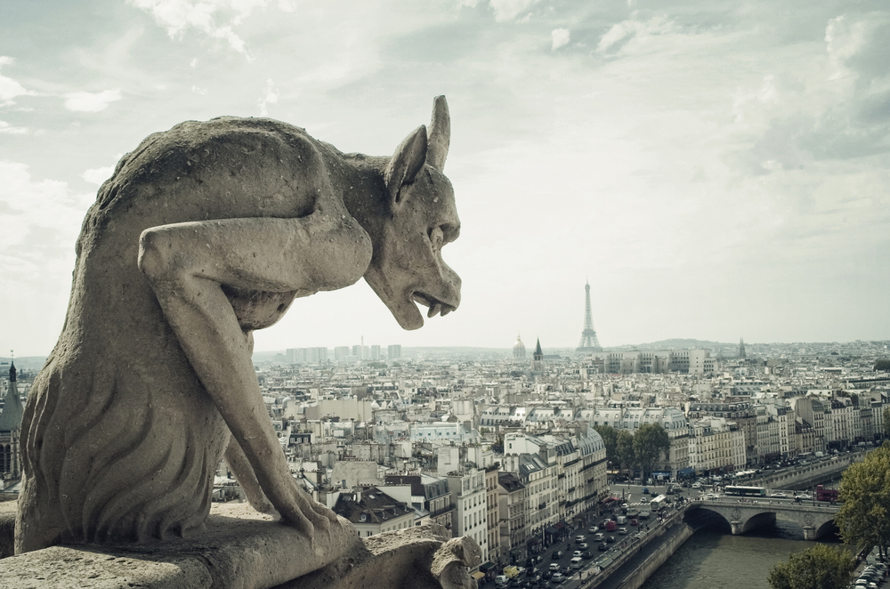
Gothic literature a literary work in a style emphasizing the grotesque, mysterious, and desolate Composition of Gothic novel Setting: a remote, abandoned, desolate location (cathedral, abbey, castle, attic) Characters: virginal maiden/ hero/ villain/ clergy (Esmeralda, Quasimodo, the archdeacon of Notre Dame) Atmosphere: medieval/ mysterious/ macabre
Gothic Horror
(It is all about the setting)

Slide 3
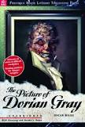
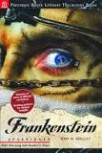
Horace Walpole, The Castle of Otranto (1764) Mary Shelley, Frankenstein (1818) Victor Hugo, The Hunchback of Notre-Dame (1831) Edgar Allan Poe, The Fall of the House of Usher (1839) “The Raven,” Emily Brontë, Wuthering Heights (1847) Robert Louis Stevenson, The Strange Case of Dr. Jekyll and Mr. Hyde (1886) Oscar Wilde, The Picture of Dorian Grey (1891) Bram Stoker, Dracula (1897) Stephen King’s novels
A Few Examples of Gothic Literature

